Slide 1




FragPicker: A New Defragmentation Tool for Modern Storage Devices
The 28th ACM Symposium on Operating Systems Principles
Jonggyu Park and Young Ik Eom
Sungkyunkwan University
Notes:
Hello, my name is Jonggyu Park.
I am from Sungkyunkwan University.
Today, I am going to talk about the fragmentation problem on flash/optane storage devices
and a new solution to address the problem

Slide 2
What is fragmentation?
a.k.a file fragmentation, filesystem fragmentation, and filesystem aging
Filesystem view
Filesystem view
Defragment!
Storage view
Storage view
Notes:
Fragmentation is a phenamenon where file blocks are scattered across multiple non-contiguous areas.
It is commonly called as file fragmentaiton, filesystem fragmentaiton, and filesystem aging.
Conventionally, we believe this significanlty degrades the I/O performance since it increases the seek time of the underlying storage.
So. What we can do is ….
#
Defrag it like this.

Slide 3



Fragmentation, is the case closed?
The number of publications
Date
Notes:
Many people think fragmention is no longer a problem on modern storage devices such flash/optane storage, since they don’t seek time.
I am not sure about it.
Let’s google it.
#
This shows the number of publications on google scholar when I search “file fragmentation”
It seems like the number is decreasing recently.
And let’s add flash here.
#
It seems like fragmentation is really not a big problem on flash storage.
How about optane devices?
I will replace flash with optane here.
#
This is not acurate because it requires the exact keyword, “file fragmentaiton” instead of other names. But we can guess that researchers don’t care about fragmentation recently.

Slide 4
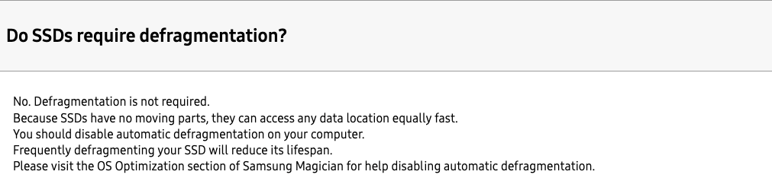





Fragmentation, is the case closed?
Let’s ask about it to the SSD vendors
For sure…?
They said sth different…
Samsung: https://www.samsung.com/semiconductor/minisite/ssd/support/faqs-03/
Intel: https://www.intel.com/content/www/us/en/support/articles/000006110/memory-and-storage.html
SK Hynix: https://skhynix.freshdesk.com/support/solutions/folders/48000658601
Notes:
Fragmentation, Is the case really closed?
Let’s ask about it to the ssd vendors. I think they can answer the question well. #
Samsung says SSDs do not require defragmentaion.
And….
#
Intels says so and even recommend disabling automatic defragmentation because it adds unnecessary wear. #
Finally, sk hynix also says the same thing and addtionally explains the reason. It says SSDs do not find data in a mechanical way unlike HDDs. #
For sure?
#
Some researchers still argue that fragmentation matters on flash storage.

Slide 5
Fragmentation: the case is not closed yet!
S. Kadekodi et. al. [4]
“Fragmentation really matters for even Flash SSDs. We even made an aging tool!”
A. Conway et. al. [3]
A. Conway et. al. [5]
C. Ji et. al. [1]
S. S. Hahn et. al. [2]
“Fragmentation significanly degrades the performance of Flash SSDs on major filesystems”
“Fragmentaion occurs even on clean SSDs”
“Fragmentation matters in mobile devices (flash).
I’ve seen it!”
[1] An empirical study of file-system fragmentation in mobile storage systems, HotStorage 2016
[2] Improving file system performance of mobile storage systems using a decoupled defragmenter, ATC 2017
[3] File systems fated for senescence? nonsense, says science!, FAST 2017
[4] Geriatrix: Aging what you see and what you don’t see. A file system aging approach for modern storage systems, ATC 2018
[5] Filesystem aging: It’s more usage than fullness, HotStorage 2019
Notes:
#
Previous research observed that fragmentation matters in mobile devices, and It happens again quickly even after defragmentation.
#
Another researcher found that fragmentation significantly degrades the performance of flash ssds on major filesystems such ext4, f2fs, and btrfs.
They replayed the problems using git scinario.
#
More recently, another study experimentally demonstrated that the performance of filesystems in the paper are actually different from the reality because of file system aging.
#
Finally, another paper argues that fragmentation really occurs on even clean SSDs. And they said regarding fragmentation, the usage is more important than fullness.

Slide 6
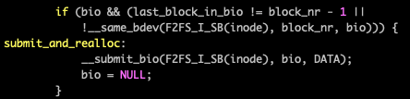
But… the vendors said no moving parts….
Let’s follow the journey of I/Os
Process
Userspace
read(file A, 1-4)
Kernel
Check the sequentiality of LBA
Filesystem
A1
…
A2
…
A3
…
A4
…
Request splitting!
Block layer
bio
bio
bio
bio
Creation
Insertion
Merging
Sorting
Staging
Dispatching
req
req
req
req
cmd
Interface
SATA/UFS/eMMc/NVMe
cmd
cmd
cmd
Request splitting
1) Increases the number of I/Os
2) Makes I/Os smaller
2) Increases their randomness
Storage
Controller
Channel 1
Channel 2
Channel 3
Channel 4
Command processing
Data fetching (DMA)
Etc.
Channel conflict
Notes:
But the SSD vendors said fragmentation is nothing because such devices have no moving parts.
Let’s look into the I/O path.
#
Suppose that a process issues a read operation. It goes through user-level libray and it's delievered to the kernel via system call.
#
And, In the filesystem layer, filesystems investigate the sequentiality of LBA of the read operation because filesystems view data in terms of LBA while applications view data using file offset.
If it’s not sequential, or contiguous, request splitting takes place.
#
Here, request splitting means a single system call is divided into multiple I/O requests.
# The problem of request splitting is that it increases the number of I/Os and makes the I/Os smaller and increase their randomness.
This significanlty affects I/O activities throughout the entire I/O stack.
#
Afterwards, the I/Os experience the block layer which performs request creation, queue insertion, merge,sort,staging for scheduling and even dispatching.
#
And then I/Os are transferred to the storage through I/O interface.
#
And finally the corresponding data will be fetched from the storage chips.
SSDs utilizes multiple parallel units to maximize I/O performance. Howveer, fragmentation decreaes the size of I/Os and increase their randomness, which hinders efficient utilization of internal resources.
Like this, fragmentation significnatly increases kernel overheads, interface overheads, and resource conflicts inside the storage.

Slide 7
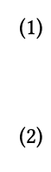
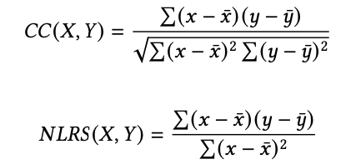
Let’s verify this “scientifically”
New terminology and metrics
Read
Frag size: the size of each fragment that are contiguous in terms of LBA
File
Frag size
Frag distance: the distance between two consecutive fragments
Filesystem
Frag distance
request
request
CC (Correlation Coefficient):
how related the value is to the performance
NLRS (Normalized Linear Regression Slope): how significantly the value influences the performance.
Notes:
To verify request splitting is the main problem, we performed some experiements.
Here we utilize new terminologies.
Frag size and frag distance.
Frag size denotes the size of each fragment
And frag distance means the distance between two fragments.
We also utlize a statistical methodology here. Correlation coefficient means how related the value is to the performance.
And linear regression slope shows how significanlty the value influences the performance.
It means that higher CC and NLRS means the value is critical to the performance.

Slide 8
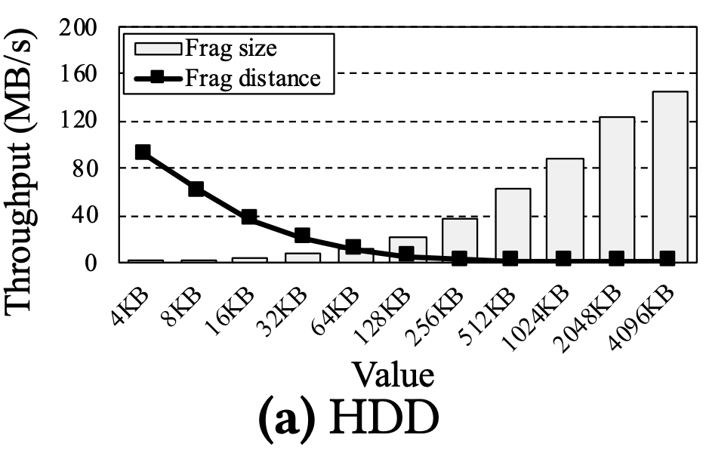
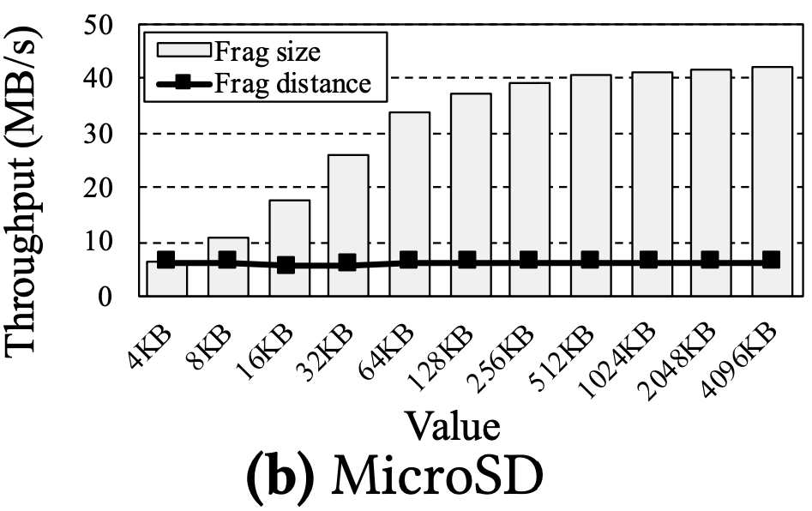
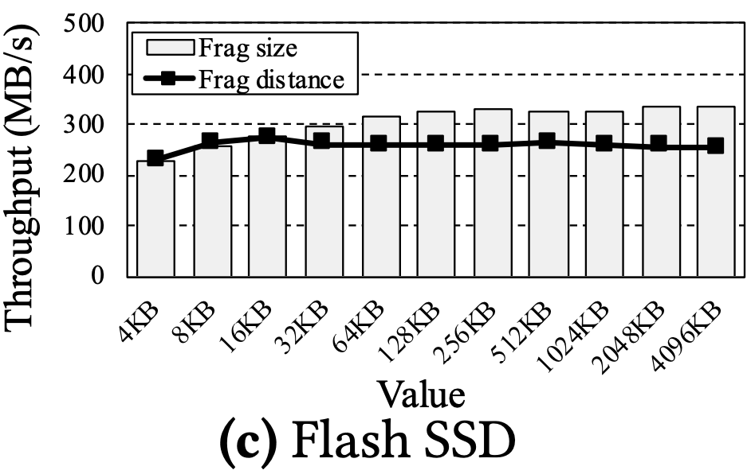
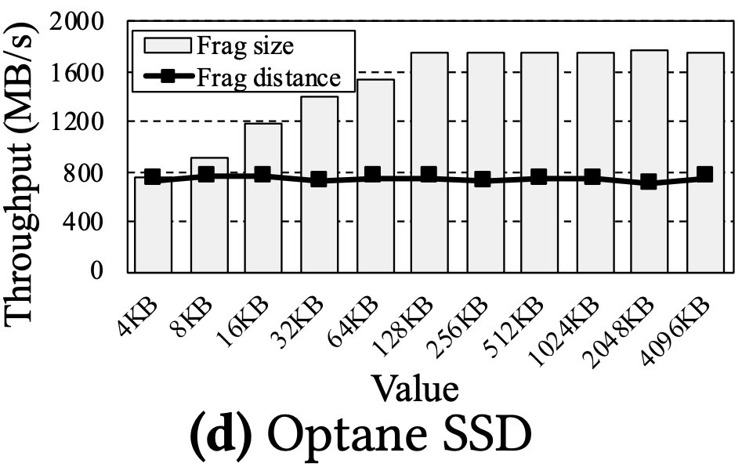
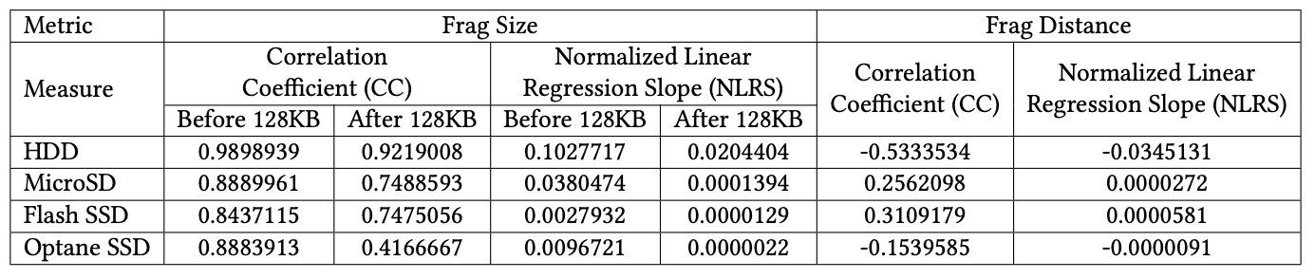
Let’s verify this “scientifically”
Evaluation Setup.
128KB O_DIRECT sequential read on F2FS
Varying frag size/frag distance
* Request splitting occurs when frag size < 128KB
Observations
1. The performance of HDD is sensitive to both frag size and distance (due to seek time)
2. Flash/Optane storage is sensitive to frag size when it’s less than 128KB.
3. Flash/Optane storage is not sensitive to frag size (>=128KB) and frag distance.
The performance of Flash/Optane storage, mostly depends on the occurrence of request splitting and is irrelevant to the distance between fragments.
Notes:
We executed 128KB DIRECT sequetnial reads on F2FS filesystem with various frag size and frag distance.
Here, since the request size is 128KB, request splitting takes place only when frag size is smaller than 128KB.
#
In the case of HDD, the performance gradually increases along with the frag size. Also, the performance decreases when the frag distance increase.
A longer frag disance means HDD requires more time locating its mechainal part on the corresponding location.
This result denotes that the performance of HDD is sensitive to both frag size and frag distance. This is because of its seek time.
#
On the other hand, none of flash/optane storage is sensitive to frag distance because they do not have seek time.
Instead, they are sensitive to frag size until the frag size becomes the request size. After that, the performance gain gets smaller.
This means, request splitting is critical to the performance of modern storage devices.
From these experiments, we can guess that the performance of modern storage devices mostly depends on the occurrence of request splitting and is irrelevent to the distance between fragments.

Slide 9
Let’s revisit defragmentation tools
Conventional defragmentation tools migrates the entire contents of files
Defragment!
Filesystem-dependent (in-place update: ext4 and xfs, out-place update: f2fs and btrfs)
Significantly degrades the performance of co-running applications
The additional writes reduce the lifespan of modern storage devices.
Time-consuming
Notes:
Let’s take a look at the conventional defragmentation tools.
First of all, they are filesystem depenedent. Since each filesystem has its own block allocation policy, they require their own defragmentaion tool to change the location of existing data. For example, ext4 and xfs adopts in-place update while f2fs and btrfs utilize out-place update.
So, ext4 has it own defragmentation tool called e4defrag while btrfs has also its own tool.
#
#
#
#
#
Second, the conventional tools are designed under the assumption that the underlying storage have seek time.
Therefore, they migrates the entire contents of data, which significnatly degrades the performance of co-running appplications.
Third, modern storage devices have a limited life span. Therefore, the additional bulk writes from defragmentation reduce their lifetime.
Finally, it is really time consuming.

Slide 10

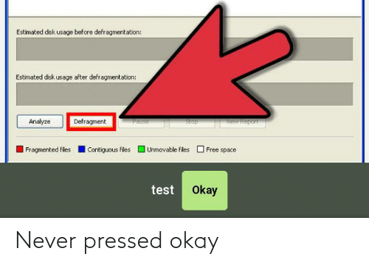
Let’s revisit defragmentation tools
Conventional defragmentation tools migrates the entire contents of files
Defragment!
Filesystem-dependent (in-place update: xfs and ext4, out-place update: f2fs and btrfs)
Time-consuming
Significantly degrades the performance of co-running applications
The additional writes will reduce the lifespan of modern storage devices.
Notes:
Therefore, ppl used to be afraid of using defragmentation….
#

Slide 11
FragPicker for modern storage devices
Let’s ignore frag distance and do our best to prevent request splitting!
Fragmented
Defragmented
Defragmented
Defrag. Tools
FragPicker
Notes:
In this paper, we attempt to mitigate such problems.
#
First, we now know frag distance is not important to the performance in modern storage devices, according to the previous experiments.
So, let’s just ignore frag distance and do our best to prevent request splitting.
#
What we want to do is
This.
#
Let’s partiallly migrates certain data., not all the data

Slide 12
FragPicker for modern storage devices
Key Challenges
1. Which data to migrate?
2. How to migrate?
Notes:
But the problem is, we need to decide which data to migrate. And how to migrate?

Slide 13
FragPicker for modern storage devices
Key Challenges
1. Which data to migrate?
I/O Analysis to find the best pieces of data blocks to prevent request splitting
2. How to migrate?
Filesystem-agnostic migration while minimizing the amount of writes
Notes:
To find out the optimal pieces of data for migration, FragPicker performs I/O analysis.
Additionally, FragPicker utilizes some techniques to perform filesystem-agnostic migration while minimizing the amount of writes

Slide 14
FragPicker for modern storage devices
FragPicker
Fragmented
Analysis
Migration
Defragmented
System Call Monitoring
Frag. Checking
Per-file Analysis
Block Allocation
Hotness Filtering
Data Migration
Analysis Phase
Monitors system calls related I/Os
Analyzes I/O characteristics per file
Filters I/Os with hotness
Migration Phase
Checks the fragmentation state
Allocates contiguous blocks
Migrates fragmented data into a new space
Notes:
To achieve this, FragPicker performs mainly two tasks.
First, the analysis phase consists of system call monioring, per-file anlaysis, and hotness filtering.
System call monitoring gather I/O information at the system call layer.
And per-file analysis anlayzes the I/O characteristics for each file.
Hotness filtering removes unneccesary pieces of data to minimize the amount of writes for defragmenation.
The Migration phase consists of fragmentation checking, block allocation, and data migration.
First, the migration phase checks the fragmentation state of each piece of data to further minimize migration data.
Afterward, FragPicker allocates a new contiguous area and migrates fragmented data into the newly allocated area.

Slide 15

The analysis phase of FragPicker
Process
Type
inode #
size
start_offset
O_DIRECT?
System Call Monitoring
R 10 130000 0 0
R 10 131072 131072 0
R 10 131072 262144 0
Userspace
.
.
.
system call
Kernel
vfs_read(…)
Extracts necessary info. using BCC (BPF Compiler Collection)
Request type (Read/Write)
Inode number
I/O size
Start offset
O_DIRECT?
Notes:
This is what the anlaysis phase does in detail.
First, FragPicker monitors the system call layer and extracts necessary information using BCC.
BCC is a toolkit for efficient kernel tracing, making use of extenteded berkeley packet filters.
Using BCC, we extract Request type, if the I/O is read or write.
And the inode nubmer.
And the I/O size.
And start offset.
And finally whether or not the i/o is Direct I/O.

Slide 16
The analysis phase of FragPicker
Process
Type
inode #
size
start_offset
O_DIRECT?
System Call Monitoring
R 10 130000 0 0
R 10 131072 131072 0
R 10 131072 262144 0
Userspace
.
.
.
system call
File Range List
Kernel
start_offset
end_offset
count
vfs_read(…)
Per-file Analysis
0 131071 100
131072 262143 3
262144 393215 64
.
.
.
Read 1-40 count =1
1. Creates per-file range list (start offset, end offset, and count)
2. Adjusts file range to be aligned with filesystem blocks
3. Applies readahead module
4. Merges overlapped I/Os and calculates the I/O counts per range
without merge
Read 31-60 count =1
Notes:
Afterwards, FragPicker performs per-file analysis. In this process, it creates per-file range list which includes start offest, and end_offest and the I/O count for each range.
And then, it adjusts the file range to be aligned with filesystem blocks. It's because Later, FragPicker performs deallocation of filesystem blocks. and the current implementation of deallocation removes any data that are not aligned with filesystem blocks.
Afterwards, FragPicker investigates if the I/Os are sequential buffered read or not.
If they are sequential buffered reads, FragPicker manipulates the file range list to reflect the readahead mechanism. Since the kernel readahead is applied under the system call layer, FragPicker should mimick the readahead machnism by itself.
Finally it merges overlapped I/Os and calculates the I/O counts.
Without merge process, the overlapped I/O ranges can incur another fragmentation after migration.
#
like this
Therefore, we merge such ranges
#
like this.

Slide 17
The analysis phase of FragPicker
Process
Type
inode #
size
start_offset
O_DIRECT?
System Call Monitoring
R 10 130000 0 0
R 10 131072 131072 0
R 10 131072 262144 0
Userspace
.
.
.
system call
File Range List
Kernel
start_offset
end_offset
count
vfs_read(…)
Per-file Analysis
0 131071 100
131072 262143 3
262144 393215 64
.
.
.
Read 1-40 count =1
1. Creates per-file range list (start offset, end offset, and count)
2. Adjusts file range to be aligned with filesystem blocks
3. Applies readahead module
4. Merges overlapped I/Os and calculates the I/O counts per range
merge
Read 31-60 count =1
Read 1-60, count =2

Slide 18
The analysis phase of FragPicker
Process
Type
inode #
size
start_offset
O_DIRECT?
System Call Monitoring
R 10 130000 0 0
R 10 131072 131072 0
R 10 131072 262144 0
Userspace
.
.
.
system call
File Range List
Kernel
start_offset
end_offset
count
vfs_read(…)
Per-file Analysis
0 131071 100
131072 262143 3
262144 393215 64
.
.
.
File Range List
start_offset
end_offset
count
Hotness Filtering
0 131071 100
262144 393215 64
393216 524287 62
Truncates the file range lists according to the hotness threshold
.
.
.
Notes:
The hotness filtering truncates the file range lists according to the hotness threshold.
In the per-file analysis, fragpicker calculates the I/O count for each range.
Using the I/O count, fragpicker only remains hot data region that are frequently accessed.
In other words, this process removes unnecesary pieces of data that are not critical to performance.

Slide 19
The migration phase of FragPicker
File range lists
start_offset
end_offset
count
Chunk 1
Chunk 2
Chunk 3
Chunk 4
0 131071 100
262144 393215 64
393216 524287 62
Chunk 1
File
Chunk 3
Chunk 4
Filesystem
Notes:
The migration phase utilizes the per-file range list that are obtained from the analysis phase.

Slide 20
The migration phase of FragPicker
File range lists
start_offset
end_offset
count
Chunk 1
Chunk 2
Chunk 3
Chunk 4
0 131071 100
262144 393215 64
393216 524287 62
Chunk 1
File
Chunk 3
Chunk 4
1. Fragmentation Checking
Filesystem
Need migration
Keep
Need migration
using “filefrag”
Notes:
First, fragpicker performs fragmentation checking against each chunk in the file range list.
#
Here, the chunk 1 is fragmented.
So it needs migartion.
#
However, the third one is actually contiguous.
So migrating it creates unnessary writes without any performance gain.
Therefore, we keep this as it is.
#
And the chunk 4 is also fragmented and thus needs migration.
Like this, this process checks the fragmentation state of each range and decides which one to migrate in order to further minimize the write amount.

Slide 21
The migration phase of FragPicker
File range lists
start_offset
end_offset
count
Chunk 1
Chunk 2
Chunk 3
Chunk 4
0 131071 100
262144 393215 64
393216 524287 62
Chunk 1
File
Chunk 3
Chunk 4
1. Fragmentation Checking
Filesystem
Need migration
Keep
Need migration
2. Block Allocation
Using fallocate()
Dealloc
In the case of out-place update filesystems, FragPicker can skip this process
In-memory
Alloc
Migrate
Notes:
Afterwards, FragPicker performs block allocation.
In the case of out-place update filesystems, simply updating the data on the same offset will change the data location.
However, in the case of in-plcae update filesystems, explicit block allocation is necessary for data migration.
Therefore, using fallocate, we allocate a contigous area in advance to migration.
The block allocation consists of deallocation and allocation.
#
#
First, FragPicker dellocate the existing blocks using fallocate punch hole and temporarily store the corresponding data in in-memory buffer.
#
Afterwards, FragPicker allocates a new contiguous area for further migration.
#
And then it migrates the data by writing them from the buffer to the new area in the next step.
Deallocation performs zeroing data that are not aligned with the filesystem blocks, to prevent falsely reading data.
However, since the per-file analysis step already adjusted the file ranges to align them with the filesystem blocks, deallocation in FragPicker does not zero any of the existing data, which means FragPicker can recover the data upon system crash.
Here, since out-place update filesystems do not require block allocation, fragpicker skips this process in that case.

Slide 22
The migration phase of FragPicker
File range lists
start_offset
end_offset
count
Chunk 1
Chunk 2
Chunk 3
Chunk 4
0 131071 100
262144 393215 64
393216 524287 62
Chunk 1
File
Chunk 3
Chunk 4
2. Block Allocation
1. Fragmentation Checking
Filesystem
Need migration
Keep
Need migration
3. Data Migration
After defragmentation
Not performance critical data
Notes:
Finally, data migration is performed using user-level I/O libraries. After defragmentation, performance critical data become contiguous and I/Os towards such data will not incur request splitting.
Since the chunk 2 is not on the file range list, we think the data are not performance critical. Therefore, fragpicker does not migrate the data.
As you can see, the frag distance can even increase after defragmentation.
However, as we saw before, frag distance is irrelevant to the performance of modern storage devices.

Slide 23
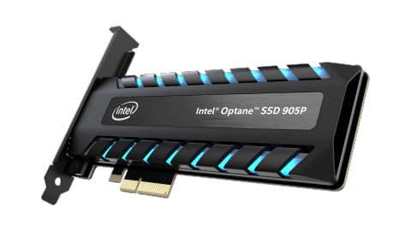
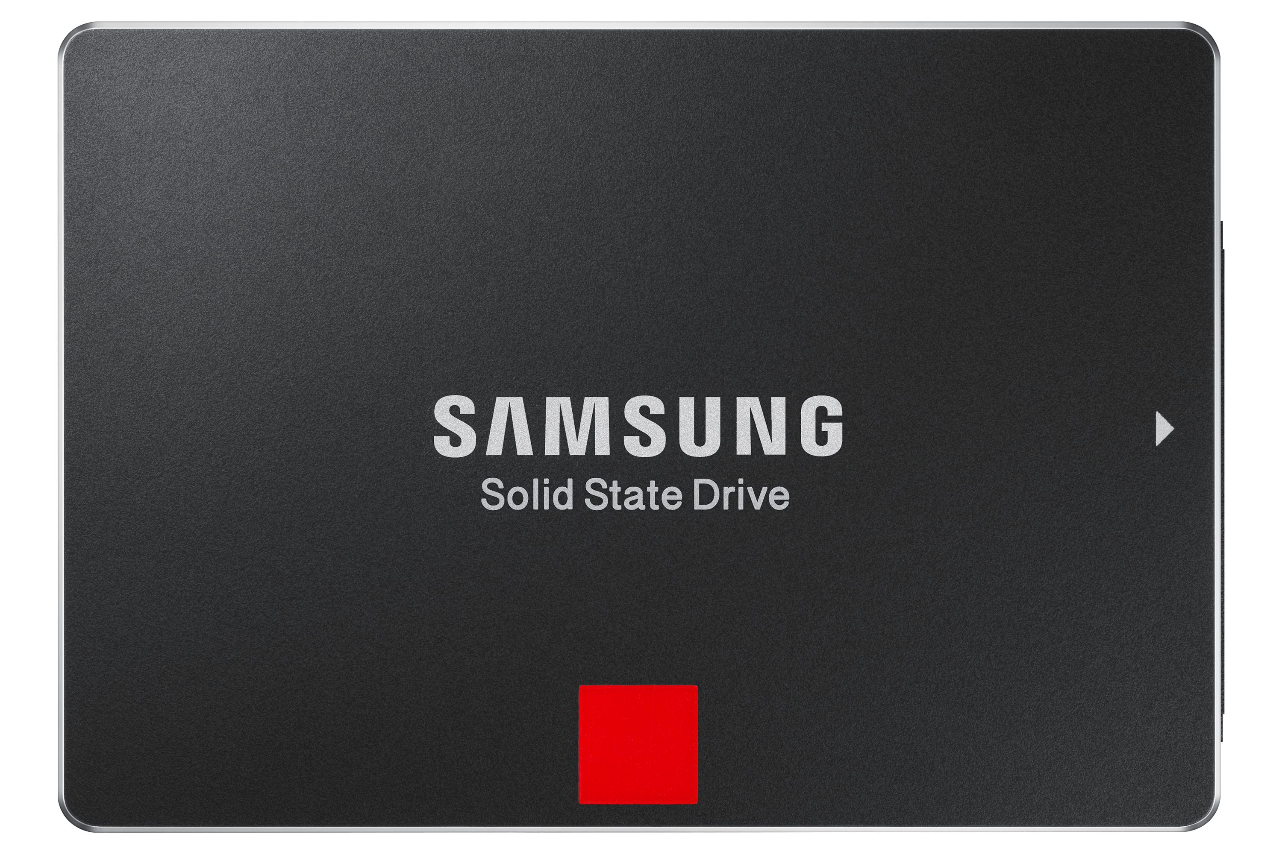
Evaluation
Storage
Samsung SATA Flash SSD 850 PRO 256GB
Intel NVMe Optane SSD 905P 960GB
Workloads
Sequential read/update
Stride read/update
Objectives
Does FragPicker reduce the amount of writes for defragmentation?
Does FragPicker achieve a similar level of performance gain, compared with conventional tools?
Notes:
To evaluate fragpicker, we used two different SSDs. One for flash and one for optane.
First, we generate fragmented files and run various workloads towards the files and measure the I/O performance.
Afterwards, we perform defragmentation and calculate the amount of writes for defragmentation and measure the I/O performance again.
We utilize four different kinds of workloads, sequential read/update, and stride read/update. Here, the unit of stride is 288KB
In these experiments, we wanna know if fragpicker can really reduce the amount of write for defragmentation
and if it can achieve a similar level of performance gain, compared with conventional tools.

Slide 24
Evaluation (Flash SSD)
1) Write amount
FragPicker reduces the amount of writes by around 50% (sequential) and 75% (stride)
2) Performance
FragPicker improves sequential/stride I/O by around 30% and 42%, respectively
Regarding stride read performance, FragPicker outperforms conventional ones by 15%
Ext4
F2FS
Btrfs
Notes:
We utilized three different major filesystems and their defragmentaion tool, ext4, f2fs, and btrfs.
Since F2FS doesn’t have user-friendly tools, we built a new one by mimicking other tools.
Here FragPicker-B bypasses the anlaysis phase and automatically creates the analysis results under an assumption that the application issues sequential I/Os.
The experimental results show that fragpicker actually does reduce the amount of writes for defragmentation.
In the case of sequential I/Os, fragpicker shows around 50% less writes and 75% less in the case of stride workloads.
This reduction in the amount of writes is because the analysis phase of FragPicker effectively finds out the optimal pieces of data for migration and fragmentation checking of the migration phase further minimmizes unnecessary writes.
In terms of performance, Fragpicker improves both sequential and stride performance by around 30% and 42%. And in the case of stride reads, fragpicker even outperforms the conventional ones.
FragPicker migrates the fragmented data in the way the data are accessed.
Therefore, FragPicker can place the data in a better way than migrating the entire contents in a sequential manner.

Slide 25
Evaluation (Optane SSD)
1) Write amount
FragPicker reduces the amount of writes by around 50% (sequential) and 75% (stride)
2) Performance
FragPicker improves sequential/stride I/O by around 75% and 120%, respectively
* High performance devices suffer from kernel overheads
Ext4
F2FS
Btrfs
Notes:
In the case of optane SSD, fragpicker could achieve around 120% performance improvement at most. It is because optane SSD is high performance storage, and the additional kernel overhead caused by request splitting is more visible.
Here, in the case of sequential reads, the performance gap between FragPicker and e4defrag shows only around 0.1% while FragPicker reduces the amount of writes by approximately 50%.

Slide 26
Evaluation (Optane SSD)
Evaluation Setup
Pre-aged ext4 on Optane 905P SSD
RocksDB ycsb-C (100% read, zipfian)
Evaluation Results
Analysis phase
Migration phase starts
Throughput (MB/s)
 | e4defrag | FragPicker
Elapsed Time (sec.) | 331 | 54
Perf. Interference | 47% | 7.4% (1.4%)
Perf. After (MB/s) | 483.5 | 467.3
Write Amount | 23GB | 7.2GB
FragPicker
e4defrag starts
e4defrag
Elapsed Time (Sec)

Slide 27
More experiments in our paper!
Database workloads
SQLite
Fileserver workloads
Hotness filtering test
...
Notes:
Our paper presents more experiments including database and fileserver worklosds.
Additionally, we also tested how sensitive the hotness threshold is to both the performance and the amount of writes in our paper

Slide 28
Discussion
SSDs are diverse
Each SSD has different FTL implementations espeically depending on the venders
Prefetching policy?
Mapping policy?
What’s the best data placement to exploit maximum performance?
Notes:
In the real world, SSDs are diverse. Their internal FTL implementation varies depending on the vendors and models.
For example, they can adopt a differnet prefetching policy or a different mapping policy.
Such difference makes different performance characteristics.
Therefore, some SSDs might benefit from bigger contiguous blocks than the request size depending on internal prefetching policies.
(We are planning to extend FragPicker to cover such cases in the future.)
In our experiments, we observed that just placing data in a sequential manner is not the best solution on some workloads.
Therefore, we think FragPicker can be utilized for not only defragmentaiton but also better data placement according to the application I/O chracteristics.
But the best data placement to exploit maximum performance is different depending on devices.
I think it will be interesting to standardize such things using various metrics.

Slide 29
Conclusion
FragPicker
A new defragmentation tool for modern storage devices
No kernel modification
Filesystem agnostic
Requirements for FragPicker
eBPF support
Filesystem-level consistency
fallocate and filefrag
Filesystem support for providing a contiguous LBA region for a single write op.
Notes:
In conclusion,
FragPicker is a new defragmentation tool for modern storage devices.
Thanks to the existing tools, it requires no kernel modification and is filesystem agnostic.
The filesystem-agnostic attribute of FragPicker can help new filesystems-in-progress evaluate the fragmentation/defragmentation effect, especially regarding aging tests.
Additionally, conventional filesystems that do not have user-friendly defragmenters, such as F2FS, can readily utilize FragPicker.
FragPicker requires the systems to support eBPF and consistency in the filesystem layer and fallocate/filefrag.
Finally it needs the filesystem ability to provide a contiguous LBA region for a single write operation since FragPicker relies on user-level I/O libraries for migration.

Slide 30
Thank you
The 28th ACM Symposium on Operating Systems Principles
Source code: https://github.com/jonggyup/FragPicker
Contact: jonggyu@skku.edu
Notes:
Thank you for listening our presentation.
The source code of FragPicker is available here.
If you have any questions or suggestions, you are welcome to contact us.

